Slide 1
Estimating Noise Transition Matrix with Label Correlations for Noisy Multi-Label Learning 基于标签相关性的噪声转移矩阵评估学习
主讲人：袁荣

Slide 2
第一遍：摘要 + 结论 + 图 + 表

Slide 3
摘要
作用：In label-noise learning, the noise transition matrix, bridging the class posterior （类后验）（不明确具体含义）for noisy and clean data, has been widely exploited to learn statistically consistent classifiers.
We first study the identifiability problem of the class-dependent transition matrix in noisy multi-label learning.
Then, we perform sample selection to extract side information about clean label correlations
Empirical results illustrate the effectiveness of our estimator to estimate the transition matrix with label correlations, leading to better classification performance.

Slide 4
结论
We study the estimation problem of the transition matrices in the noisy multi-label setting.
We propose a new estimator to approximate the transition matrix.
The proposed estimator utilizes the information of label correlations, and demands neither anchor points nor accurate fitting of noisy class posterior.

Slide 5
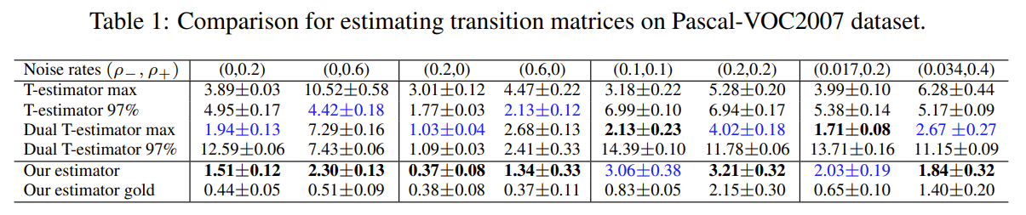
表格
对于其中的各个指标解释详见实验部分

Slide 6
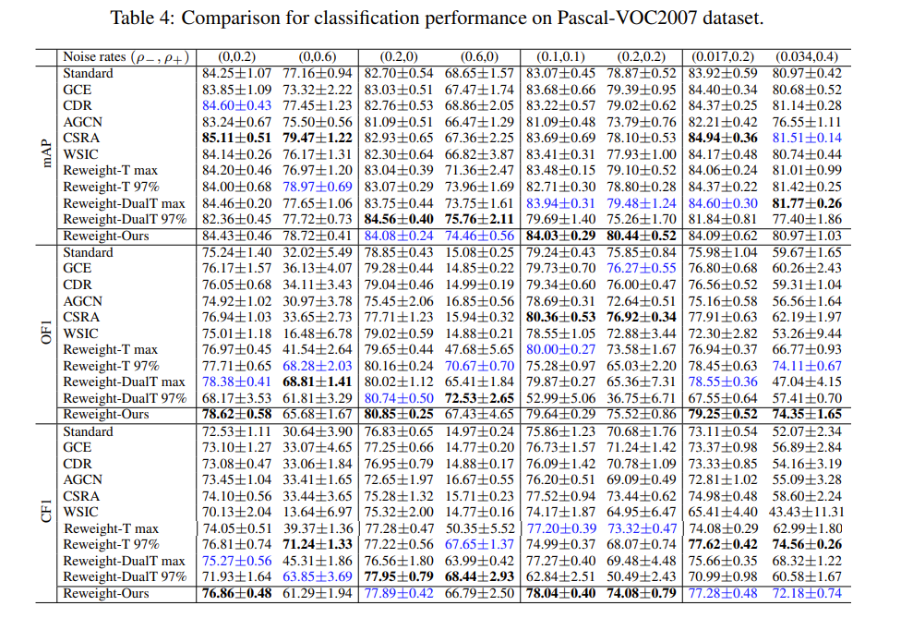

Slide 7
第二遍：算法 + 实验

Slide 8
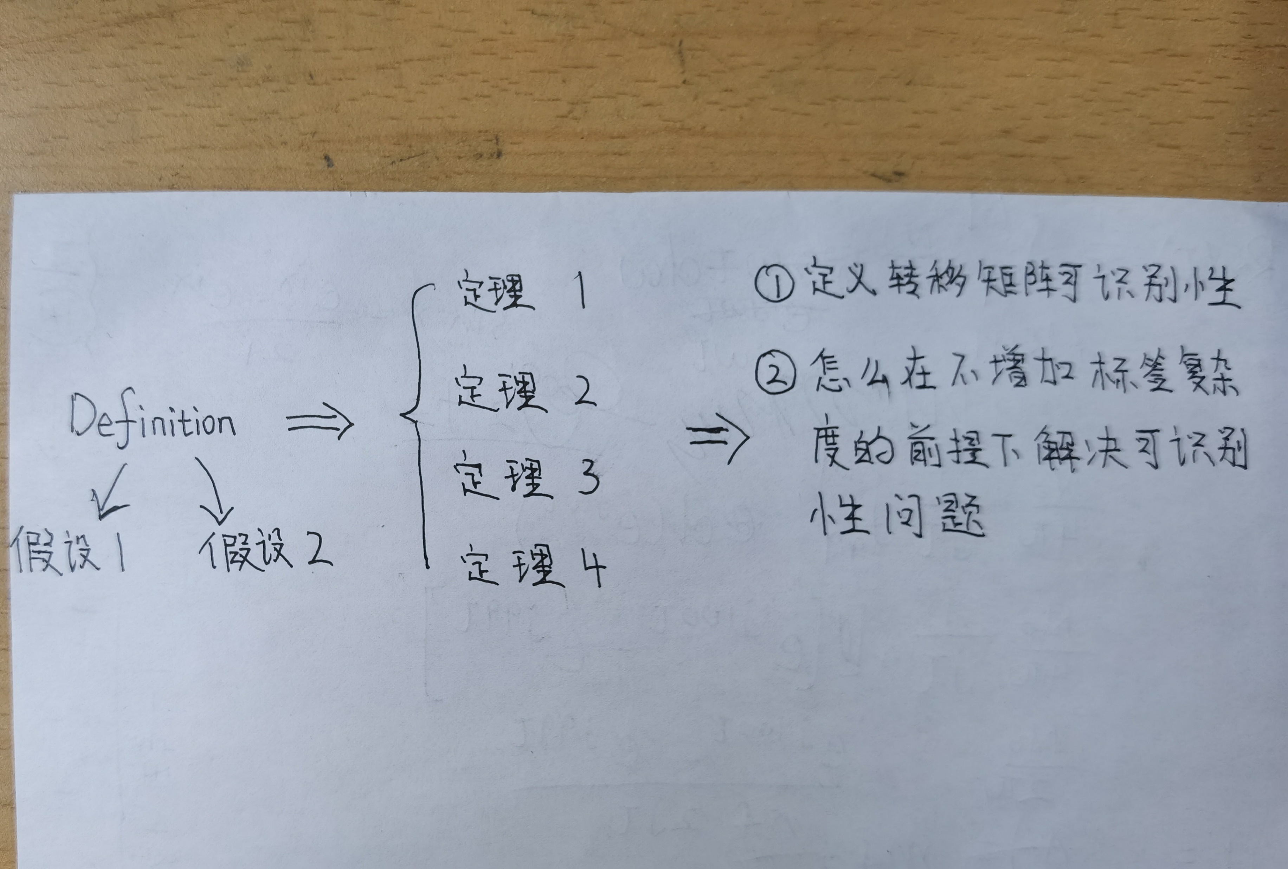
算法（Section 3）
Identifiability of transition matrix

Slide 9

Our estimator
When implementing sample-selection-based methods, a major concern is whether the sampling bias will lead to large estimation errors.（memorization effect）
实际上是：
Our empirical results justify this by showing a little gap between the estimation error of our estimator with the biased sample selection and an unbiased one.
从而提出transition matrices .

Slide 10
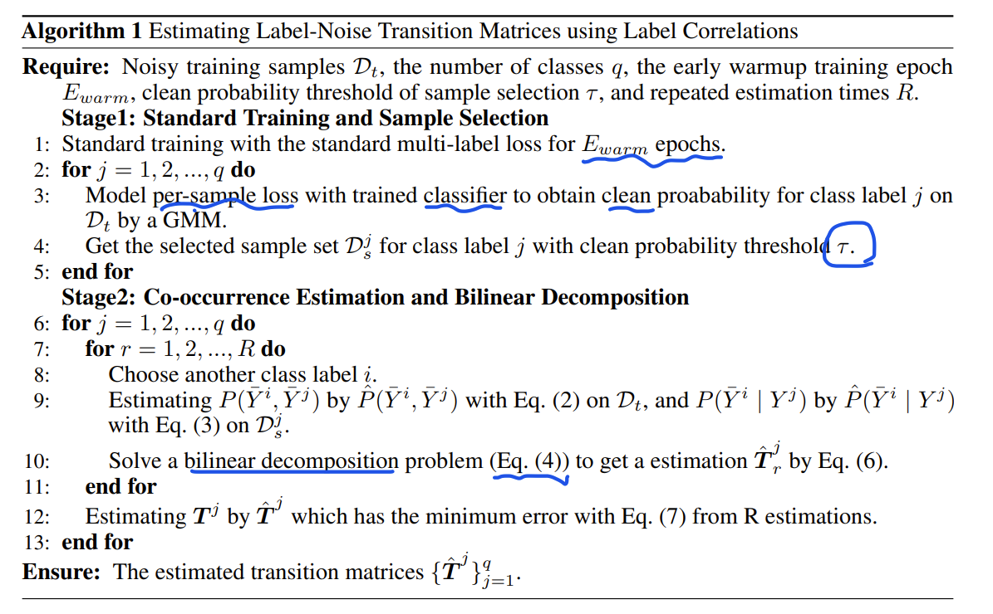

Slide 11
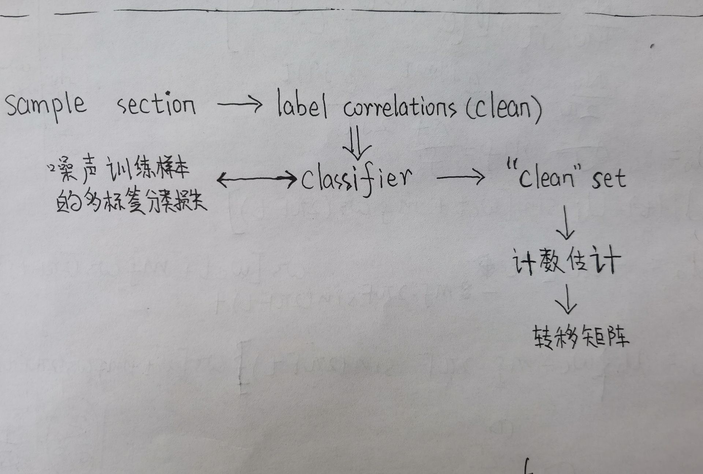

Slide 12
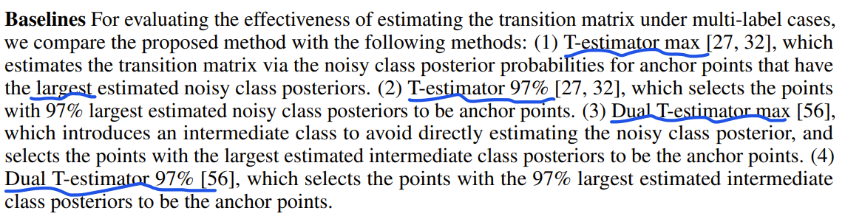
实验（Section 4）
Comparison for estimating transition matrices
Besides, to study the ablation of sampling bias, we also run our method with an unbias sample selection, named "our estimator gold". We can see that sample bias is the main factor that contributes to the error for our estimator, but the little error gap between our estimator and our estimator gold shows it will not lead to large estimation error.

Slide 13
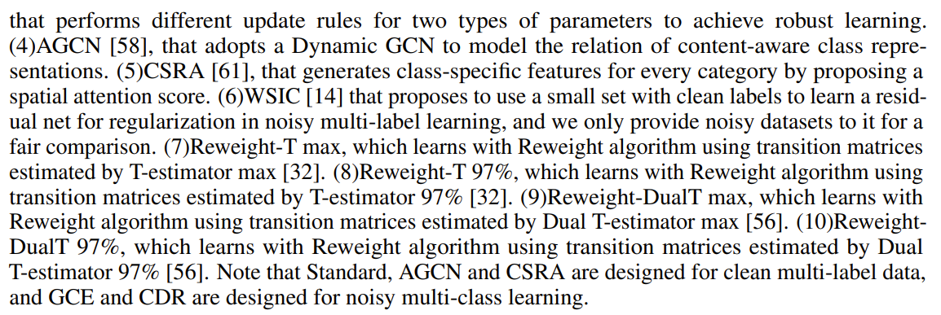
Comparison for classification performance

Slide 14
存在的疑问

Slide 15
Class posterior 具体该怎么理解？
Ablation studies 是关于哪个方面的研究？
Identifiability of transition matrix 转移矩阵的识别度主要是着眼于类与类之间是否独立吗？

Slide 16
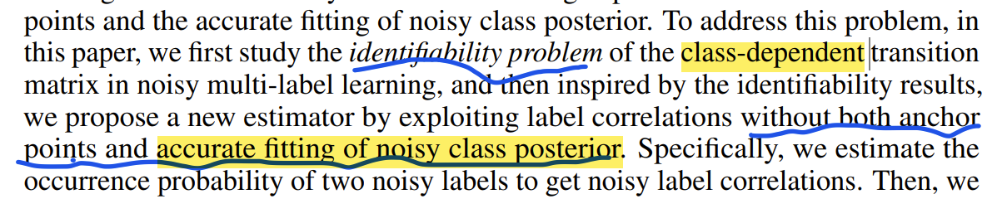

Slide 18
